Slide 1
E-Learning Management System
(E-Learn)

Slide 2
Software Requirements Specification (SRS)
PURPOSE:
THE PURPOSE OF THIS DOCUMENT IS TO SPECIFY THE REQUIREMENTS FOR THE DEVELOPMENT OF THE E-LEARNING MANAGEMENT SYSTEM.
SCOPE:
THE E-LEARNING MANAGEMENT SYSTEM WILL PROVIDE A PLATFORM FOR THE CREATION, DELIVERY, AND MANAGEMENT OF ONLINE COURSES, ASSESSMENTS, AND OTHER EDUCATIONAL CONTENT.

Slide 3
Software Requirements Specification (SRS)
PRODUCT FEATURES:
USER MANAGEMENT
COURSE MANAGEMENT
ASSESSMENT AND EVALUATION
COMMUNICATION
REPORTING AND ANALYTICS
ADMINISTRATION

Slide 4
Software Requirements Specification (SRS)
USERS:
STUDENTS
INSTRUCTORS
ADMIN

Slide 5
USERS
STUDENTS:
BUYS THE COURSE AND ENROLL IN IT.
COMPLETES THE ASSESSMENTS.
TRACKS THE PROGRESS.

Slide 6
USERS
INSTRUCTORS:
CREATES OR ADD THE COURSES.
MANAGES THE COURSES.
CONDUCTS ASSESSMENTS.
MANAGES THE STUDENTS.

Slide 7
USERS
ADMINISTRATORS:
MANAGES THE SYSTEM CONFIGURATION.
MANAGES THE USER ROLES.

Slide 8
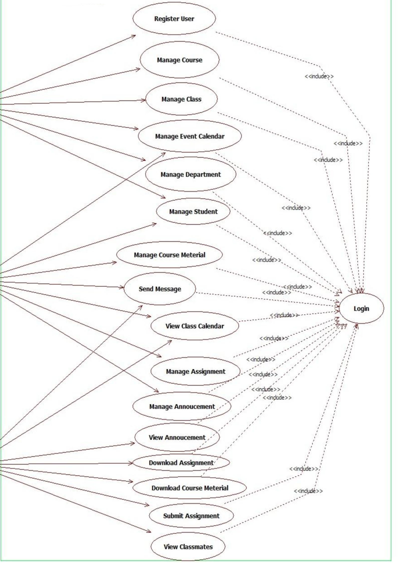
CASE DIAGRAM
ADMIN
INSTRUCTOR
STUDENT

Slide 9
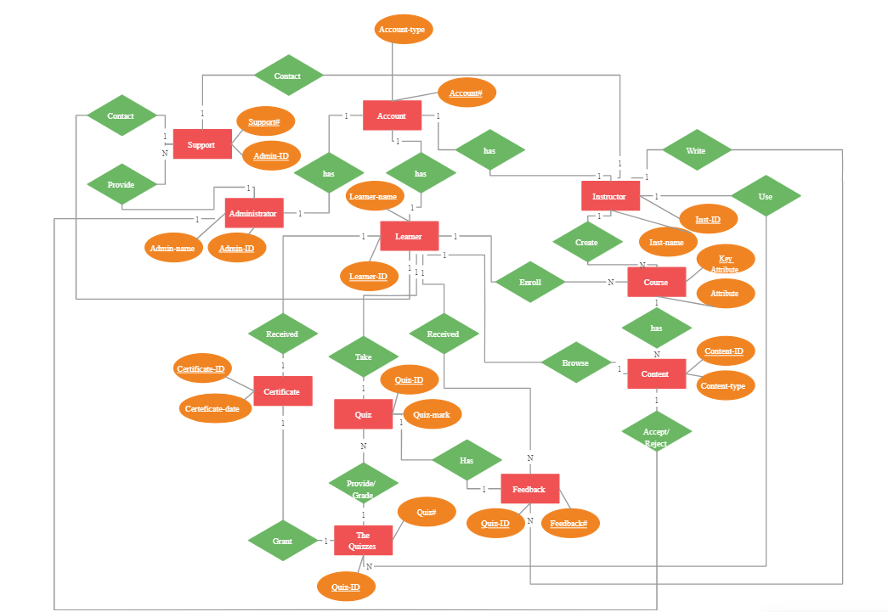
ER-DIAGRAM

Slide 10
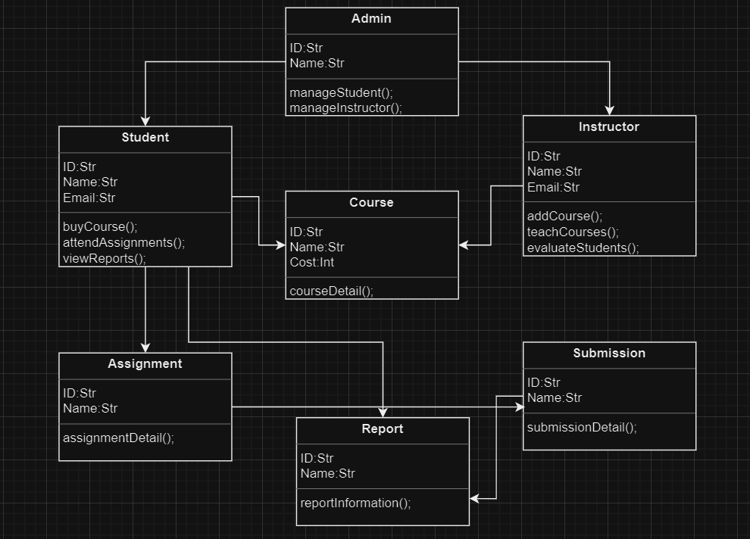
CLASS DIAGRAM

Slide 11
GITHUB
https://github.com/SECE-BATCH-2022-2026/project-pitching-event-source-code-ppt-eee_team-16

Slide 12
THANK YOU
PROJECT BY:
TARUUN PRASATH G S
MATHIMALAR C
SWETHA A

